Slide 1
Code Abhyaas Basics -- 01

Slide 2
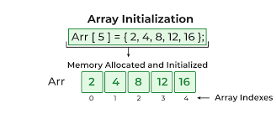
Arrays:
It is a linear data structure(elements are arranged in a sequential order)
It is a collection of data elements of specified type
Size of array is fixed. Index starts at 0 and ends at length-1(only for one dimensional array)

Slide 3
1.Program To find largest element in an array.
Sample Input: 5
: 20,16,36,14,30
Sample Output: 36

Slide 4
2.Program to find frequency of given element in the array
Sample Input: 6
: 12,4,8,4,6,4
:4
Sample Output: 3

Slide 5
3.Program to move all zeroes to end of array
Sample Input: 9,0,3,4,0,0,1,0
Sample Output: 9,3,4,1,0,0,0,0

Slide 6
4.Program to rearrange a string according to the given indices.
Sample Input: ahpyp
: [1,0,2,4,3]
Sample Output: happy

Slide 7


